Slide 1
College Dropouts
Conner Nance, Laryssa Revelli, and Tanner Hooper

Slide 2
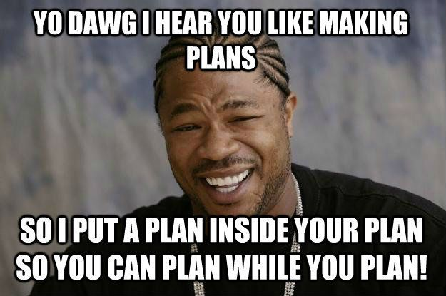
Lessons learned
D3 is possessed
No need for explanation
Better Planning will always save time when working as a group.
Central filtering
Allocate more time for finishing touches
Styling, popup explanations
Thoroughly examine data to accommodate limitations before implementation

Slide 3
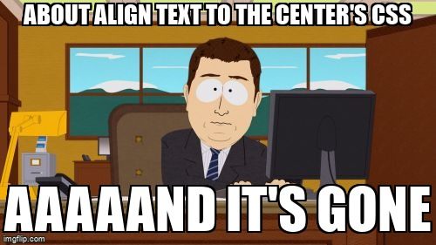
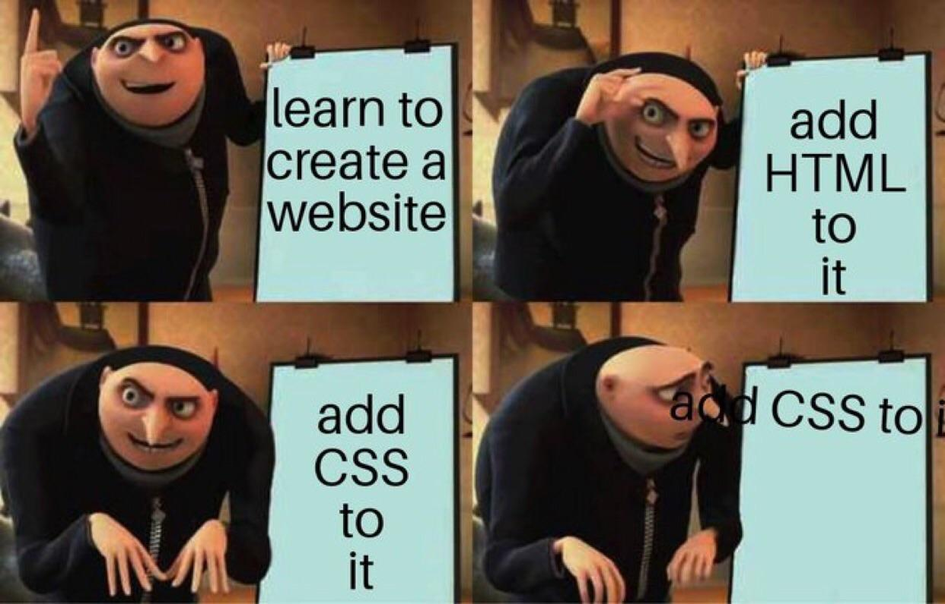
Roadblocks
Null or Privacy Suppressed data
Wyoming
Lack of data on athlete dropout rates
Combining different filters
CSS

Slide 4
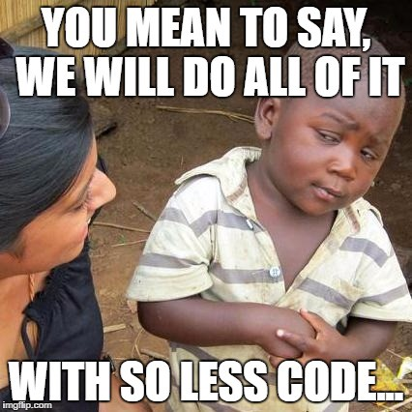
Insights
Don’t reinvent the wheel
The more feedback you get,
the better the visualization
Code documentation is vital
when working with a group

Slide 5
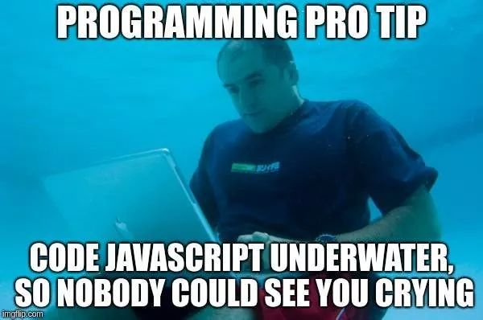
Insights
Combined line charts are
better for comparison
Arrow keys are useful
for easily navigating years
Add more filtering options
for user customization

Slide 6
Questions/
Recommendations?

